Slide 1





Don’t bet against the US economy
01 · THE US ECONOMY
Growth above 2%
G7’s strongest in 2026
RBC expects the US to post the strongest growth in the G7 in 2026, held up by four supports.
Wealthy consumers
Tight labor market
Fiscal support
AI investment
~2/3
~20%
4.1%
~1/2
of GDP is consumer spending
of US income is government transfers
unemployment rate
the growth pace without it
RBC Economics, US Executive Briefings (Apr, Jun, Sep 2026)
1
Notes:
RBC's core 2026 narrative, restated in the September Executive Briefing: a resilient high-income consumer, a solid labor market, generous fiscal spending and an AI-powered investment boom. The April briefing says the US is still likely to produce the strongest growth in the G7 in 2026. The June briefing notes the consumer accounts for nearly two-thirds of US GDP. The September briefing says nearly 20% of US income comes from government transfers, and that without the AI investment boost US growth would have run about half as fast in 2026.

Slide 2



A US economy that absorbs shocks
01 · THE US ECONOMY
SHOCKS HITTING IT
STILL STANDING
Energy shock
4.1%
Unemployment, down from 4.3% at the start of summer.
Middle East conflict pushes headline inflation above 3%.
YET
Tariffs
2%+
Underlying growth, slightly above the 2% trend.
Trade-war costs show up in producer and consumer prices.
Fed tightening
80K
Jobs added a month, versus 10K a month in 2025.
First hike in three years, with two more expected this year.
Source: RBC Economics, US Executive Briefings (Apr, Sep 2026)
2
Notes:
Left: the shocks. Energy prices from the Middle East conflict (April briefing: headline inflation above 3%), tariff pass-through now visible in producer and consumer prices, and the Fed's first hike in three years in September, with two more expected this year. Right: what is still standing. Unemployment fell from 4.3% to 4.1% over the summer, underlying growth is slightly above 2%, and payrolls are averaging about 80,000 a month after only 10,000 a month in 2025. The columns are not paired one-to-one. The point is the contrast between the pile of shocks and the resilience of the aggregates.

Slide 3
Growth runs on productivity, not hiring
01 · THE US ECONOMY
JOBS A MONTH
GDP GROWTH IN 2026
Hiring is beating what the economy needs
AI investment is doing heavy lifting
Break-even pace (RBC estimate)
With the AI investment boom
~20K
Full pace
Actual recent pace
Without it
~80K
About half
Record retirements and slower immigration shrink labor supply, so far fewer jobs are needed to hold unemployment steady.
RBC puts first-half growth under 1% without it. An AI-driven productivity surge may still be ahead.
Source: RBC Economics, US Executive Briefings (Apr, Sep 2026); bar lengths illustrative
3
Notes:
Left: RBC's estimate of break-even job growth has fallen to about 20,000 a month because of record retirements and slower immigration, while the US is now averaging about 80,000 a month (September briefing). Bar lengths are drawn in proportion to those two numbers. Right: the April briefing frames the economy as growing on the back of productivity rather than hiring, and says the AI-driven productivity surge is probably still ahead. The September briefing flags the dependency: without the AI investment boost, US GDP growth would have run about half as fast in 2026, under 1.0% in the first half. The right-hand bars are illustrative of that half-as-fast comparison, not of exact growth rates.

Slide 4
Demographics are ruling everything
02 · DEMOGRAPHICS
TWO ENDS OF THE AGE CURVE
52.8M
From retirees to young adults, the age profile now shapes labor supply, spending and housing demand.
retired Americans in 2025
1.7M
22%
up from 39.6M in 2015
~10M
Americans retired in 2025
of 25–35s live with family
aged 25–35
young adults living with a parent or grandparent
Source: RBC Economics (Jun 2025, Sep 2026); circle areas to scale
4
Notes:
Two ends of the age curve. The retired population reached 52.8 million in 2025, up from 39.6 million in 2015, and retirements topped 1.7 million in 2025 (America needs workers, not jobs, June 2025). On the other end, about 22% of 25-to-35-year-olds, roughly 10 million people, were living with a parent, grandparent or parent-in-law in 2025 (How much housing demand in the US still lives at home?, September 2026). The circle areas are drawn to scale with each other.

Slide 5


Retirees are a hidden tailwind
02 · DEMOGRAPHICS
1.7M
$75T
3.5%
Retirements in 2025
Boomer wealth
Expected 2027 COLA
Up from about 1.2M a year before the pandemic.
Retirees spend from savings, mostly on services like health care.
Inflation-adjusted benefits for 57M+ Social Security recipients.
1970–2010
about 1-to-1
LABOR MARKET
Retirees per unemployed new entrant
Since 2010
nearly 3-to-1
Retiree
Unemployed new entrant
Source: RBC Economics (Jun 2025; Sep 2026)
5
Notes:
Top row: retirements topped 1.7 million in 2025 versus about 1.2 million a year between the financial crisis and the pandemic. Baby Boomers hold nearly $75 trillion of wealth, spend out of savings rather than labor income, and weight spending toward services, particularly health care. Social Security supports over 57 million beneficiaries and is inflation adjusted, with a 2027 COLA of 3.5% expected; the September briefing flags that if inflation cools while COLAs stay elevated, benefits meant to support retirees could fuel broader price pressure. Bottom band: the ratio of retirees to unemployed new entrants was roughly 1-to-1 between 1970 and 2010 and has risen to nearly 3-to-1 since, which means retirements are creating job openings for people looking for work. Person icons are a pictogram of those ratios.

Slide 6
Housing demand still lives at home
02 · DEMOGRAPHICS
Every 100 young adults (25–35)
IF THE LIVING-AT-HOME SHARE FALLS 2 POINTS
675K
units of added housing demand
66% rental
34% owner
Rental vacancy is 7.3%, the highest since 2019, so there is room to absorb it.
WHAT HOLDS YOUNG ADULTS BACK
+36%
Housing costs since 2019, against +35% for young-adult weekly earnings.
5%+
Unemployment for recent grads, versus 4.1% for all workers.
Live with family and stay (20)
Move out in the scenario (2)
Mid-6%
Mortgage rates, versus a record-low 2.96% average in 2021.
Already live independently (78)
Source: RBC Economics, “How much housing demand in the US still lives at home?” (Sep 2026)
6
Notes:
From RBC's September 22 piece. About 22% of 25-to-35-year-olds lived with a parent, grandparent or parent-in-law in 2025, roughly 10 million people. The dot grid shows that share as 22 of every 100: 20 blue dots stay at home and 2 yellow dots are the people who would move out if a normalizing entry-level job market pulled the share down by 2 percentage points. RBC estimates that would create about 675,000 units of incremental housing demand, split roughly 66/34 between rental and owner. That is more renter-heavy than recent household growth, which was about 63% owner. The rental market can absorb it, with vacancy at 7.3%, the highest since 2019. What holds household formation back: housing costs up about 36% since 2019 against 35% for young-adult weekly earnings, unemployment for recent graduates well above 5% versus 4.1% overall, and mortgage rates that went from a record-low 2.96% average in 2021 to a mid-6% range. Propensity increases across all subgroups explain 71% of the weakness between 2006 and 2019, so affordability and financing, not marriage patterns, are the dominant drivers.

Slide 7
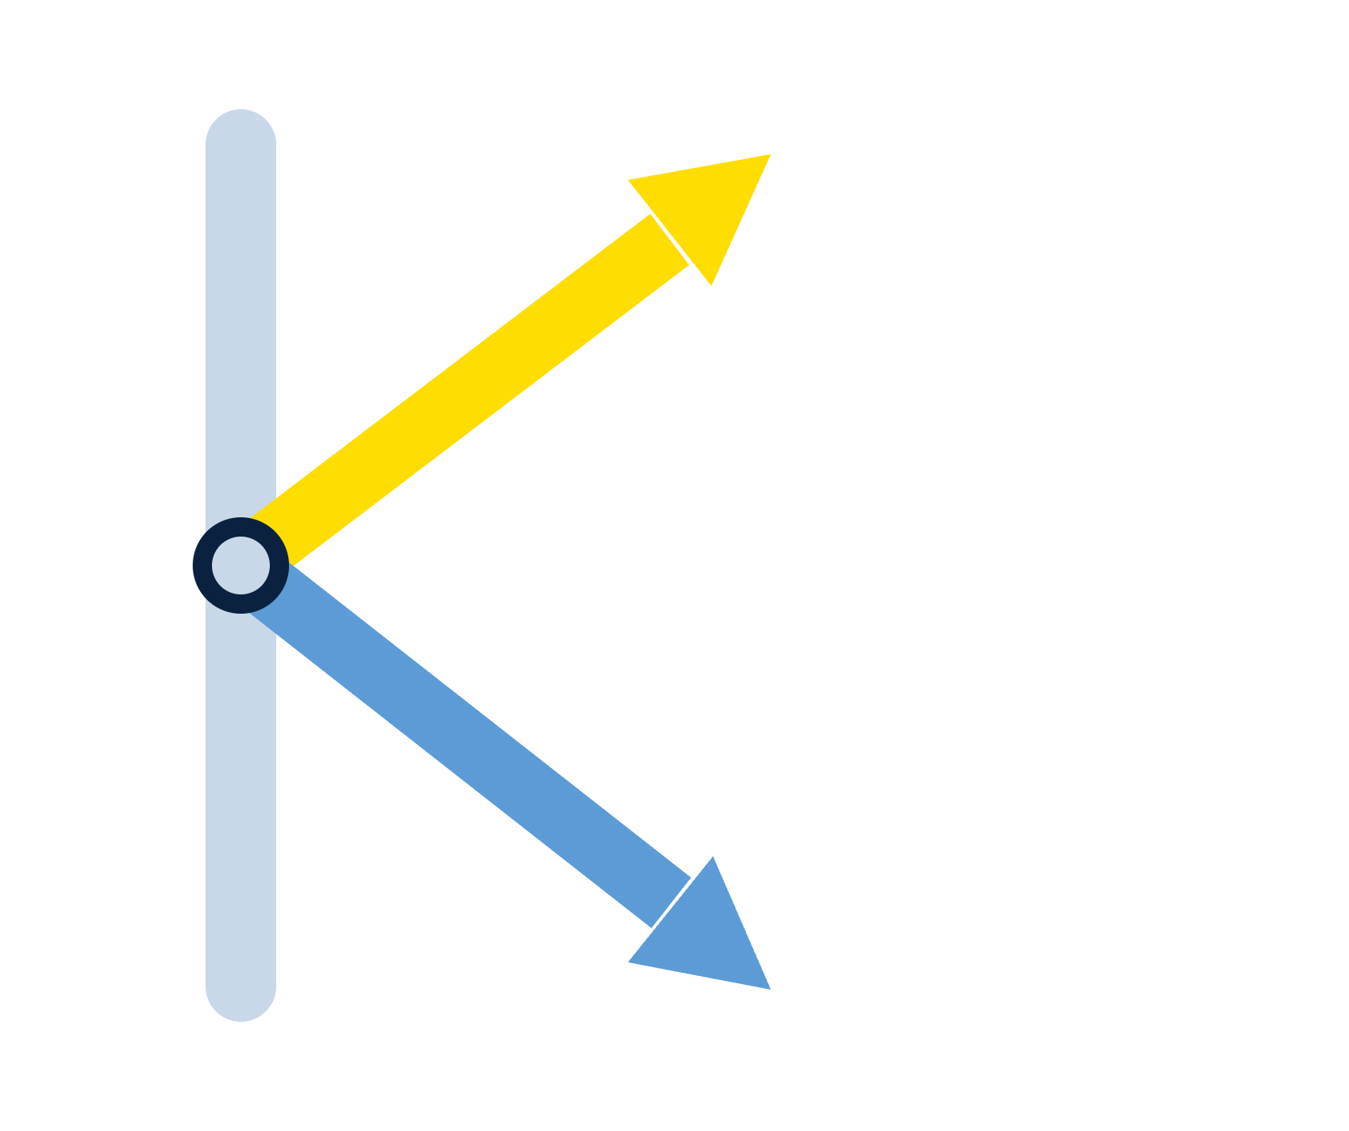
The K-shaped economy is redefining America
03 · THE K-SHAPED ECONOMY
Top 10–20%
of households drive consumption growth
Aggregate growth looks steady, but households are moving along very different paths.
Consumer sentiment has weakened as a predictor of aggregate spending.
Bottom 80%
have minimal reserves and falling real wages
ONE ECONOMY, TWO PATHS
Source: RBC Economics (Nov 2025; Jun, Sep 2026)
7
Notes:
RBC's K-shape thesis. The top 10 to 20% of income earners, flush with appreciating liquid assets, are driving consumption growth. The bottom 80% hold minimal financial reserves, and real wages have been trending negative since April, particularly for low and middle-income households. RBC's June briefing says the K-shape is still in effect and likely widening, and its November 2025 analysis says apparent consumer strength is largely an illusion created by the top of the K, and that consumer sentiment has weakened as a predictor of aggregate consumption.

Slide 8


The top of the K carries the spending
03 · THE K-SHAPED ECONOMY
Who owns US corporate equities
87%
13%
Top 20% of households
The other 80% of households hold the remaining 13%.
Top of the K
Bottom of the K
Income from dividends, rent and interest.
Income from paychecks; real wages negative since April.
$30T
~$5T
2.6%
2.5%
added to liquid assets by the top 10% since 2020.
the most any other group added.
saving rate in April, a point below February.
of income goes to interest; 2.8% preceded past recessions.
Spending power is concentrated where wealth is, so a stock market correction hits the spending engine directly.
Source: RBC Economics (Nov 2025; Jun, Sep 2026)
8
Notes:
Top bar: RBC's November 2025 analysis says the top 20% of households hold about 87% of directly and indirectly held corporate equities, which makes a stock market correction a bigger risk to growth than weakness at the bottom of the K. The top 10% poured roughly $30 trillion into liquid, income-generating assets since 2020, six times more than any other group, whose cumulative flows peaked near $5 trillion. Bottom of the K: wages are the main income source for low and mid-income households, whereas the top 10% draw more from dividends, rent and interest. Real wages have trended negative since April, the savings rate fell to 2.6% in April (June briefing), and non-mortgage personal interest payments consume 2.5% of disposable income, near the 2.8% threshold that preceded the three pre-COVID recessions (September briefing). The 87/13 bar is drawn to scale.

Slide 9


Two households, two sets of decisions
03 · THE K-SHAPED ECONOMY
Top of the K
Bottom of the K
1
Spend from asset income
1
Draw down savings
Dividends, rent and interest keep growing.
The saving rate was 2.6% in April.
2
Shrug off inflation
2
Borrow more
Less affected by higher prices.
Revolving credit ran 3.8% above a year earlier in Q2.
3
Watch the market
3
Trade down or cut back
A stock correction is the risk to spending.
Lower-quality goods, less discretionary spending.
The “average” consumer hides two very different customers: steady growth on top, diverging choices underneath.
Source: RBC Economics (Nov 2025; Jun, Sep 2026)
9
Notes:
Households at the top of the K spend from asset income and are less affected by inflation, so their behavior is tied to equity markets; RBC sees a stock market correction as the bigger threat to growth. Households at the bottom face negative real wages and cumulative price increases of about 27% since 2019 (November 2025 analysis), and the options are to draw down savings, borrow more or trade down and cut back. RBC's June briefing adds that the new measure of consumer health is not whether someone has a job, but whether they work enough hours and earn enough to cover the cost of living. For businesses and policymakers, the average growth outlook can understate the strength of the high-end consumer and overstate the strength of the average American.

